Slide 1
Interactions between Potassium Management and Soil Mineralogy T.S. Murrell, IPNI IPNI Webinar, 9 Sep. 2014.

Slide 2
Outline
Factors the U.S. is currently using to make K recommendations
Dominant minerals in the U.S. Midwest that affect K
Discuss how soil mineralogy affects:
the accuracy of assessing K soil fertility by soil testing methods
how soils respond to K additions or K withdrawals

Slide 3
Factors the U.S. is currently using to make K recommendations

Slide 4
K recommendations for maize
Surveyed publications
31 States in the Mississippi River Basin were examined
1 State did not have published K recommendations for corn (WV)
Counted how many factors are considered in each state when making rate determinations
A “factor” is something that can be changed by the user
Listed the factors

Slide 5
Number of K recommendation factors per state
Average = 3 per state

Slide 6
18 factors across 30 states
Some factors are proxies for soil mineralogy (highlighted in red)

Slide 7
Dominant minerals in the U.S. Midwest that affect K

Slide 8
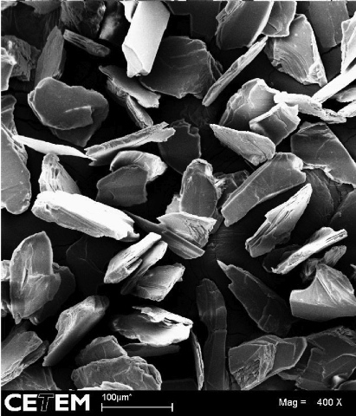
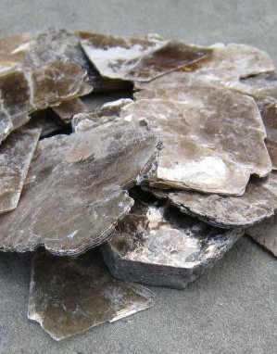
Phyllosilicates: Layer Structure
Photo: Michele Hogan
da Silva, A. de A.S., J.A. Sampaio, A.B. da Luz, S.C.A. França, and C.M. Ronconi. 2013. Modeling controlled potassium release from phlogopite in solution: Exploring the viability of using crushed phlogopite rock as an alternative potassium source in Brazilian soil. J. Braz. Chem. Soc. 24:1366-1372.

Slide 9
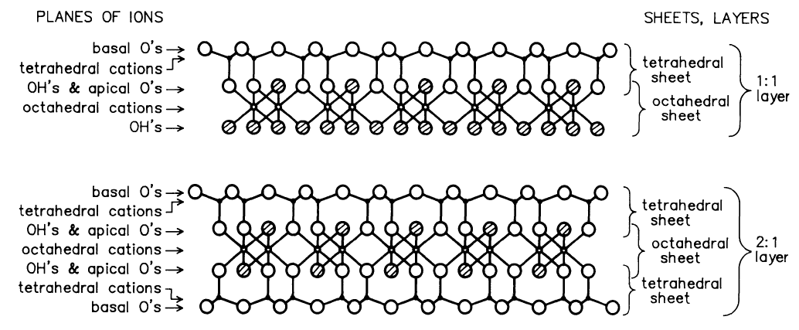
Basic Phyllosilicate Types
Schulz, D.G. 1989. An introduction to soil mineralogy. p. 1-34. In J.B. Dixon and S.B. Weed (eds.) Minerals in Soil Environments. 2nd ed. SSSA, Madison, WI..

Slide 10
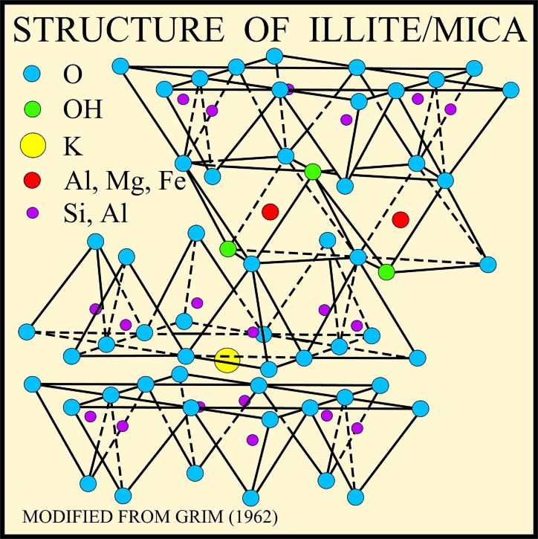
“Fixed” K Mica and Illite examples
“Fixed K”
Image available at: http://pubs.usgs.gov/of/2001/of01-041/htmldocs/clays/illite.htm (verified 5 Jan. 2014).

Slide 11
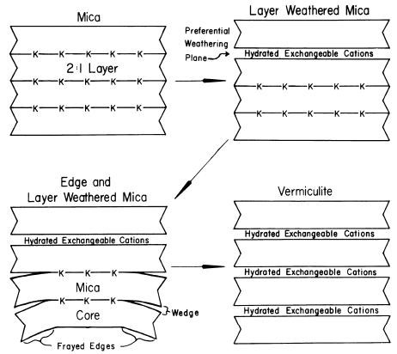
Mica Weathers to Other Minerals
Fanning, D.S. V.Z. Keramidas, and M.A. El-Desoky. 1989. Micas. p. 551-634. In J.B. Dixon and S.B. Weed (eds.) Minerals in Soil Environments. 2nd ed. SSSA, Madison, WI..

Slide 12
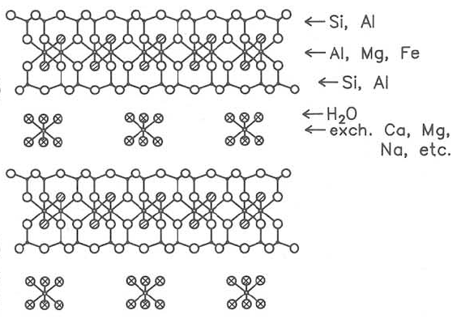
Vermiculites and Smectites (Swelling minerals)
Interlayer cations in vermiculites and smectites are hydrated (have water around them) and are exchangeable
Vermiculite has a higher layer charge than smectite
Fanning, D.S. V.Z. Keramidas, and M.A. El-Desoky. 1989. Micas. p. 551-634. In J.B. Dixon and S.B. Weed (eds.) Minerals in Soil Environments. 2nd ed. SSSA, Madison, WI..

Slide 13
Illite (Non-swelling mineral)
Vermiculite (Charge = 0.9)
Illite often occurs interlayered with smectite (I-S crystals)
Percentage of illite in I-S crystals varies
Illite (Charge = 1.8)
Montmorillonite (Charge = 0.5)
Illite (Charge = 1.8)
Dehydrated K⁺ ion Hydrated K⁺ ion
Vermiculite (Charge = 0.9)
Meunier, A., B. Lanson, and D. Beaufort. 2000. Vermiculitization of smectite interfaces and illite layer growth as a possible dual model for illite-smectite illitization in diagenetic environments: A synthesis. Clay Minerals 35:573-586.

Slide 14
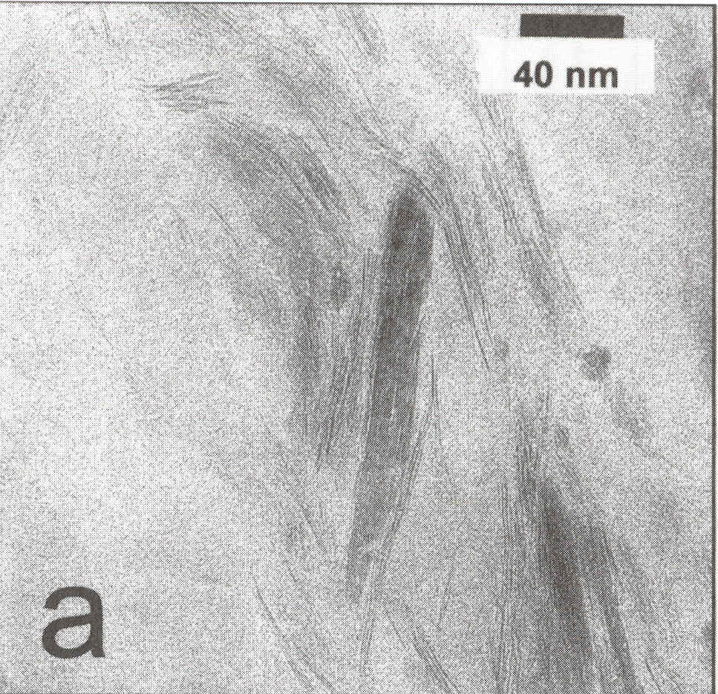
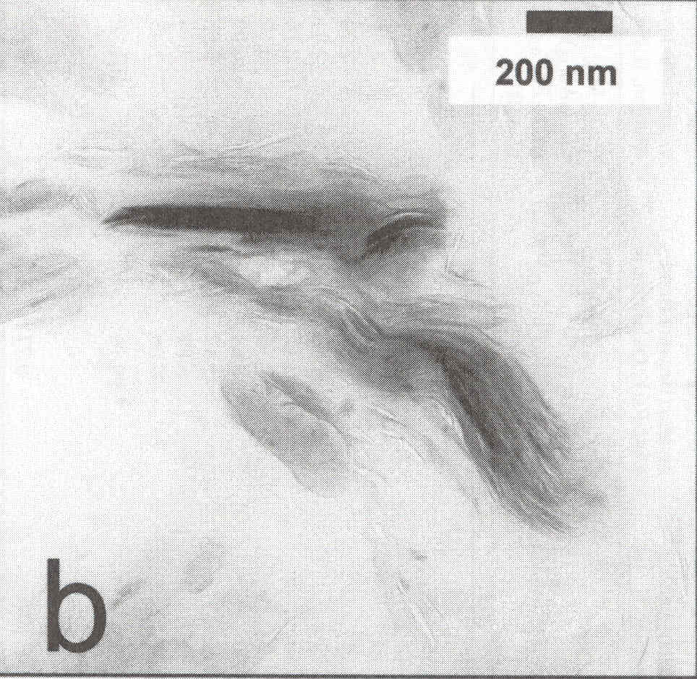
Transmission Electron Micrograph Shows “Feathering” of Mineral Edges
B. Joern, Purdue Univ. (personal communication)

Slide 15
Effect of Iron Reduction on K Fixation
Sample | Treatment | Fe²⁺ as a percent of total Fe | Fixed K
 |  | (%) | (cmol(+) kg⁻¹)
Smectite SWa-1 | Unreduced | 0.16 | 2.9
 | Reduced | 74.0 | 31.5
Smectite API 25 | Unreduced | 5.8 | 3.0
 | Reduced | 66.8 | 25.3
Fithian Illite | Unreduced | 25.4 | 135.7
 | Reduced | 60.8 | 89.8
Under reducing conditions:
smectites “fixed” K
illite released K
Shen, S. and J.W. Stucki. 1994. p.173-185. In J. Havlin and J.S. Jacobsen (eds.) Soil testing: Prospects for improving nutrient recommendations.

Slide 16
Interaction of Soil Moisture and K Addition
Pre-leached with K₂SO₄
Behaves like illite
No K added
Behaves like smectite
Eden Soil Series: Ap horizon
Greater reduction
Dowdy, R.H. and T.B. Hutcheson Jr. 1963. Soil Science Society of America Proceedings 27:31-34.

Slide 17
“Center of Gravity” Concept: Area-Weighted Average of Peak Positions
Center of gravity (cg)
Smectite-rich mixed layer minerals (1.46 nm)
Illite-rich mixed layer minerals (1.16 nm)
Poorly crystallized illite (1.02 nm)
Well crystallized illite (1.00 nm)
Hydroxy-interlayered phases (1.42 nm)
°2θ Cu Κα
Barré et al. 2008. Plant Soil 302:213-220.

Slide 18
Cumulative K Budgets
Treatments | Total K applied | Total K removed | K budget
 | ------------------------------- (kg K ha⁻¹) --------------------------------
0 | 580 | 4088 | -3508
P | 580 | 4771 | -4191
K | 5980 | 4478 | 1502
PK | 5980 | 5030 | 950
0 init | 0 | 3824 | -3824
PK init | 8090 | 4597 | 3493
Experiment started in 1959 and lasted for 40+ years
Barré et al. 2008. Plant Soil 302:213-220.

Slide 19
Potassium Budgets Impact Mineralogy
More smectite-rich
K removal ≈ K application
K removal > K application
K removal < K application
ŷ = 1.30 - 4.20×10⁻⁶x
More illite-rich
Barré et al. 2008. Plant Soil 302:213-220.

Slide 20
Summary
Pure mineral phases are not common
Interstratification is common, and Illite-Smectite (I-S) interstratification exists in many Midwestern agricultural soils
Some evidence exists that K enrichment may cause mineralogical changes (smectite to illite example)

Slide 21
Mineralogy affects: The accuracy of assessing K soil fertility by soil testing methods

Slide 22
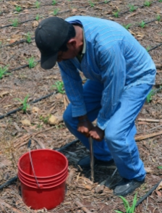
Comparison of soil sample preparation
Dry Method (conventional)
Wet Method
Drying
Sieving
Sieving
Moisture determination
Subsampling for analysis

Slide 23
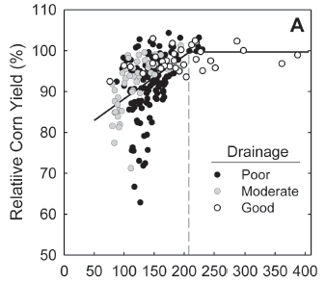
Wet vs. Dry Sample Preparation Affects Soil Test Calibration Relationships
Barbagelata, P.A. and A.P. Mallarino. 2013. Soil Science Society of America Journal 77:318-327.

Slide 24
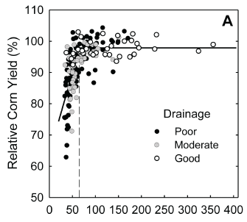
Wet vs. Dry Sample Preparation Affects Soil Test Calibration Relationships
Barbagelata, P.A. and A.P. Mallarino. 2013. Soil Science Society of America Journal 77:318-327.

Slide 25
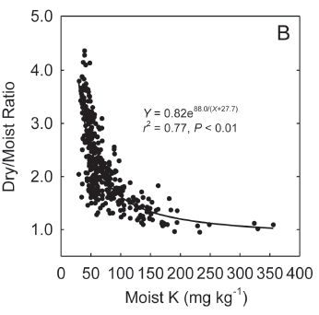
Dry/Wet Ratio and Critical Level
At lower soil test K levels, dried samples produce higher readings than moist samples
At or above the critical level, the two methods of preparation produced the same results
Barbagelata, P.A. and A.P. Mallarino. 2013. Soil Science Society of America Journal 77:318-327.

Slide 26
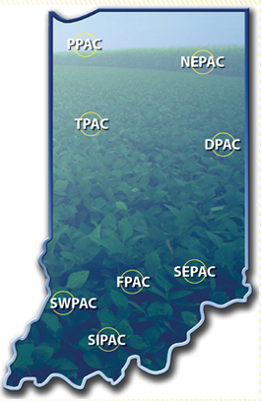
Soil Test vs. What the Plant “Sees”
Newly summarized studies are showing that a soil test may not be well related to the fertility the plant “sees” at specific sites.
Long-term research at Purdue showed that soil testing was a poor indicator of fertility at 3 out of 5 sites where corn was grown in long-term fertility experiments.

Slide 27
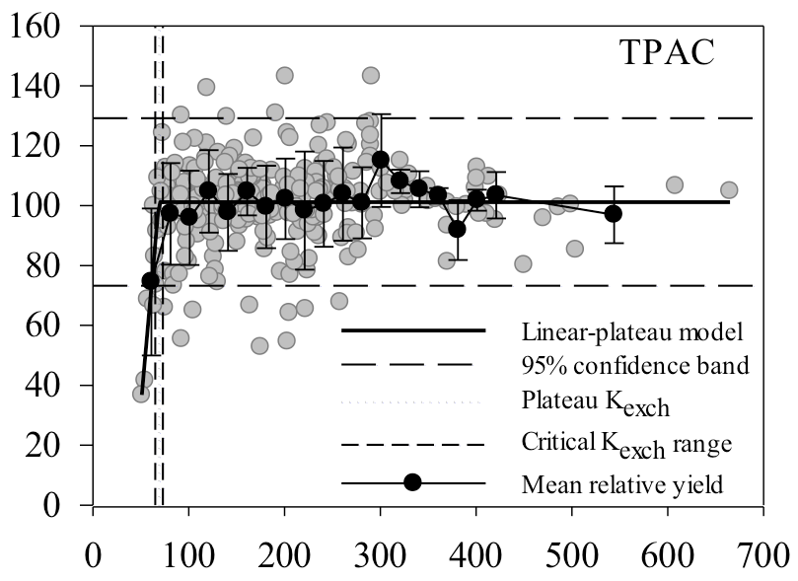
Example of a location where lower soil tests are associated with lower soil fertility
R.Navarette-Gonchozo. 2013. Personal communication (Purdue University)

Slide 28
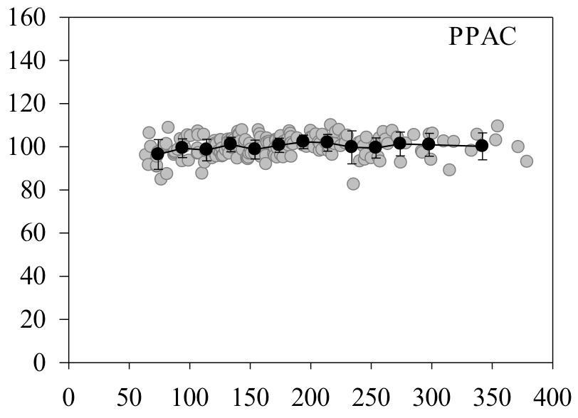
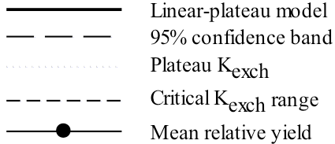
Example of a location where lower soil tests are not associated with lower soil fertility
Tracy sand
R.Navarette-Gonchozo. 2013. Personal communication (Purdue University)

Slide 29
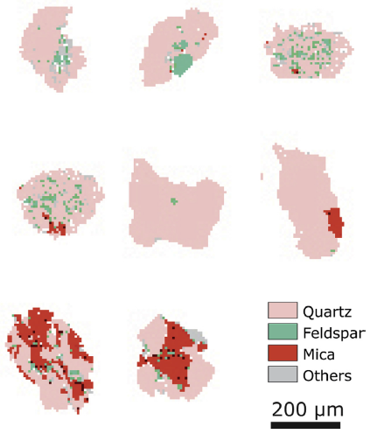
Fine Sand Particles Can Have Mineral Inclusions
Fine Sand (100 – 250 μm)
Individual quartz grains contained inclusions of
Feldspar
Mica
May help explain why some sands seem to have an adequate supply of K
Meyer, M.C., P. Austin, and P. Tropper. 2013. Quantitative evaluation of mineral grains using automated SEM-EDS analysis and its application potential in optically stimulated luminescence dating. Radiation Measurements 58:1-11.

Slide 30
Summary
Critical soil test levels are lower with the wet K test
Variability appears smaller, but what about relative differences?
Differences in moist and dry values decrease exponentially as the critical level is approached
Different sites may have different critical levels and levels of crop responsiveness
New studies showing mineral inclusions in sands may indicate why some coarse textured soils may not be as responsive as expected

Slide 31
Mineralogy affects: How soils respond to K additions or K withdrawals

Slide 32
Seasonal variation in soil test K
1994
1995
1996
1997
Ebelhar et al. 1997. Personal communication. Soil test values are ammonium acetate extractable.

Slide 33
Year-to-Year Variability Impacts Soil Test Response to Nutrient Budgets
Villavicencio and Mallarino, 2011. Personal communication

Slide 34
Nutrient “Uplift”
Nutrient uplift: Plants take up K from lower in the soil profile. This K is then deposited at the soil surface after maturity as K is leached from the residue.
Even though soil fertility declines with crop removal, uplift may keep such changes from being detected
Example: movement of banded K from the sub-surface to the surface
Jobággy, E.G. and R.B. Jackson. 2004. Ecology 85:2380-2389.

Slide 35
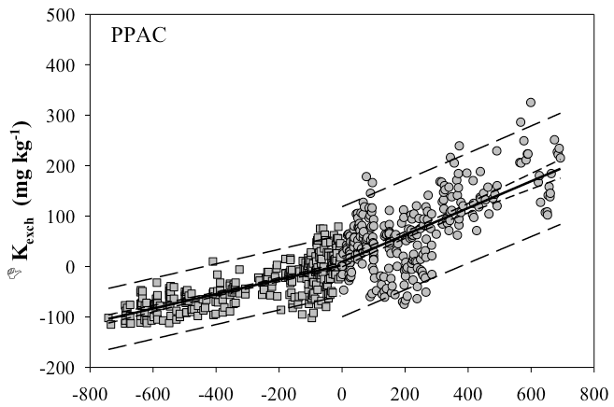
Buildup and Drawdown Buffer Capacities May Not Be the Same
K budget and K uplift move soil test K in same direction
4.0 lb K₂O/acre to build the soil test 1 ppm
K budget and K uplift move soil test K in opposite directions
7.7 lb K₂O/acre to draw the soil test down 1 ppm
R.Navarette-Gonchozo. 2013. Personal communication (Purdue University)

Slide 36
Gaps in Our Understanding
Soil fertility evaluation
To what extent are mineralogical changes affecting the accuracy and precision of soil testing methods?
Can mineralogical factors be incorporated into soil test interpretations?
Is there a relationship between dry/moist ratio and critical level? Does some equilibrium exist in interstratified minerals that determines crop response to K addition?
Soil fertility control
How are changes in mineralogy affecting the ability to evaluate nutrient budgets and their intended effects on soil test levels?

