Slide 1
Crops Access More Potassium Than Is in a Soil Test T. Scott Murrell Potassium Program Director, IPNI 2017 Indiana CCA Conference, Indianapolis, IN. 12-13 Dec. 2017.

Slide 2
Outline
Minerals with potassium (K) that is not detected by standard soil tests
What a standard K soil test measures
How plants access more K than is in a soil test
Create concentration gradients in the rhizosphere
Exude H⁺ and organic acids into the rhizosphere
Form symbiotic relationships with microbial communities in the rhizosphere

Slide 3
Minerals with Potassium That Is Not Detected by Standard Soil Tests

Slide 4
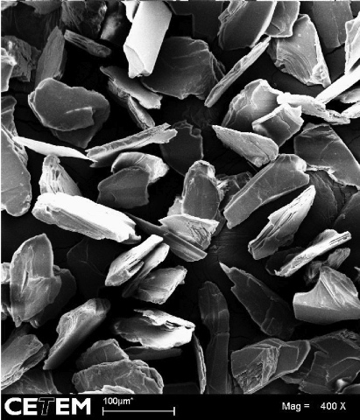
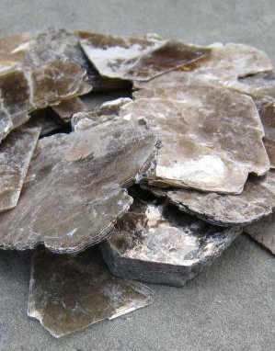
Phyllosilicates: Layer Structure
Photo: Michele Hogan
da Silva, A. de A.S., J.A. Sampaio, A.B. da Luz, S.C.A. França, and C.M. Ronconi. 2013. Modeling controlled potassium release from phlogopite in solution: Exploring the viability of using crushed phlogopite rock as an alternative potassium source in Brazilian soil. J. Braz. Chem. Soc. 24:1366-1372.

Slide 5
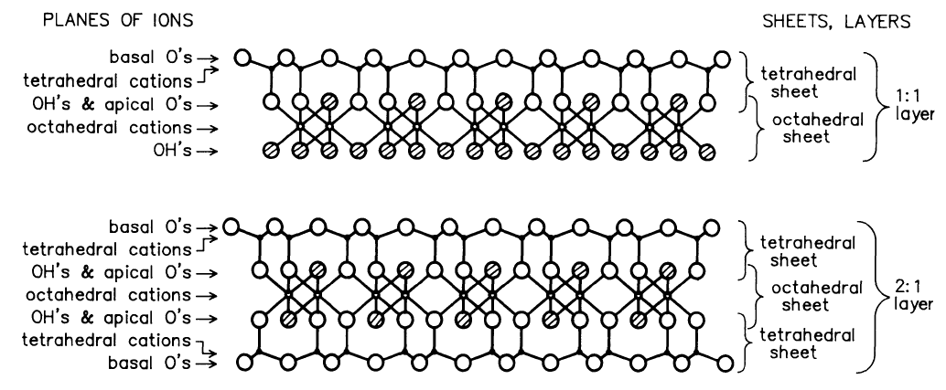
Basic Phyllosilicate Types
kaolinite
mica, illite, vermiculite, smectite
Schulz, D.G. 1989. An introduction to soil mineralogy. p. 1-34. In J.B. Dixon and S.B. Weed (eds.) Minerals in Soil Environments. 2nd ed. SSSA, Madison, WI. Figure 1-6.

Slide 6
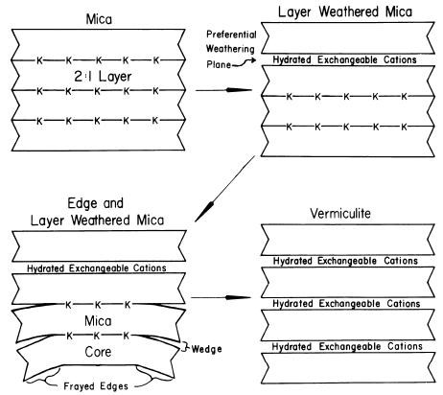
Mica Weathers to Other 2:1 Minerals
Fanning, D.S. V.Z. Keramidas, and M.A. El-Desoky. 1989. Micas. p. 551-634. In J.B. Dixon and S.B. Weed (eds.) Minerals in Soil Environments. 2nd ed. SSSA, Madison, WI. Figure 12-11.

Slide 7
Major 2:1 Phyllosilicate Minerals with Interlayer K
Relative degree of soil development | Ideal mineral | Interlayer distance | Layer charge | Interlayer K hydration?
 |  | (nm) | (negative charge per formula unit)
4 | Mica: Biotite | 1 | 1 | no
4 | Mica: Phlogopite | 1 | 1 | no
7 | Mica: Muscovite | 1 | 1 | no
7 | Illite | 1 | 0.6 – 0.8 | no
8 | Vermiculite | 1.4 | 0.6 – 0.9 | yes
9 | Smectite | 1.2 – 1.5 | 0.2 – 0.6 | yes
Fanning, D.S. V.Z. Keramidas, and M.A. El-Desoky. 1989. Micas. p. 551-634. In J.B. Dixon and S.B. Weed (eds.) Minerals in Soil Environments. 2nd ed. SSSA, Madison, WI. Table 12-1. Rai, D. and J.A. Kittrick. 1989. Mineral equilibria and the soil system. p. 161-198. In J.B. Dixon and S.B. Weed (eds.) Minerals in Soil Environments. 2nd ed. SSSA, Madison, WI. Table 4-3.

Slide 8
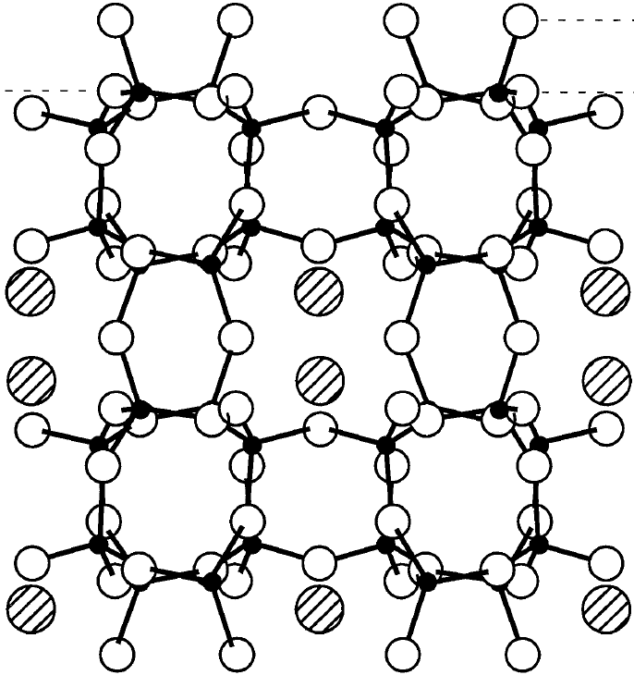
Tectosilicates (Feldspars)
Made up of tetrahedra with one silicon surrounded by four oxygens
Potassium in the structure balances negative charges in the structure and is bound more loosely than silicon and oxygen
Fenter, P. et al. 2000. Geochimica et Cosmochimica Acta 64(21):3663-3673.

Slide 9
What a Standard Potassium Soil Test Measures

Slide 10
Ammonium Acetate and Mehlich III Extractants
Hydrated ions
mineral layer
Na⁺
K⁺
NH₄⁺
Mg²⁺
Ca²⁺
Extractant
Mehlich, 1985; Warnke and Brown, 1998

Slide 11
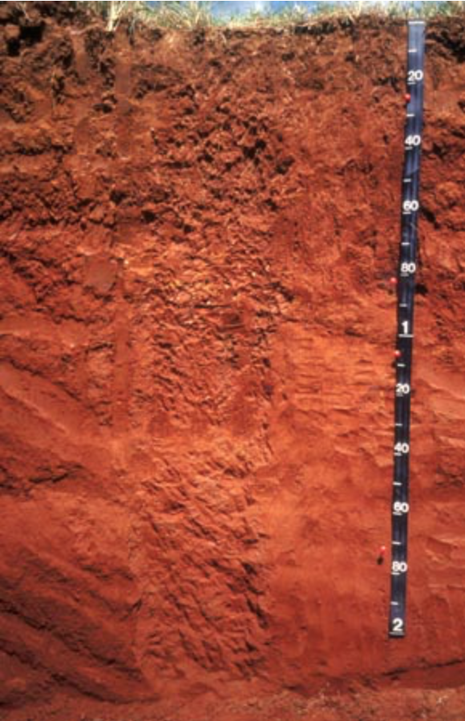
There Are Conditions where Soil Tests Can Quantify Most of the K Plants Access
Study located in north Florida
Corn grown under pivot irrigation
Orangeburg loamy fine sand (Fine-loamy, kaolinitic, thermic Typic Kandiudult)
Ultisol: low supply of basic cations
Kandic horizon: low activity clay from 7 to 72 inches, composed mainly of 1:1 layer silicate clays with a lower CEC
Kaolinitic: more than 50% kaolinite
Obreza, T.A. and F.M. Rhoads. 1988. Soil Science Society of America Journal 52:701-706; https://www.nrcs.usda.gov/wps/portal/nrcs/detail/soils/survey/office/ssr7/profile/?cid=nrcs142p2_048004

Slide 12
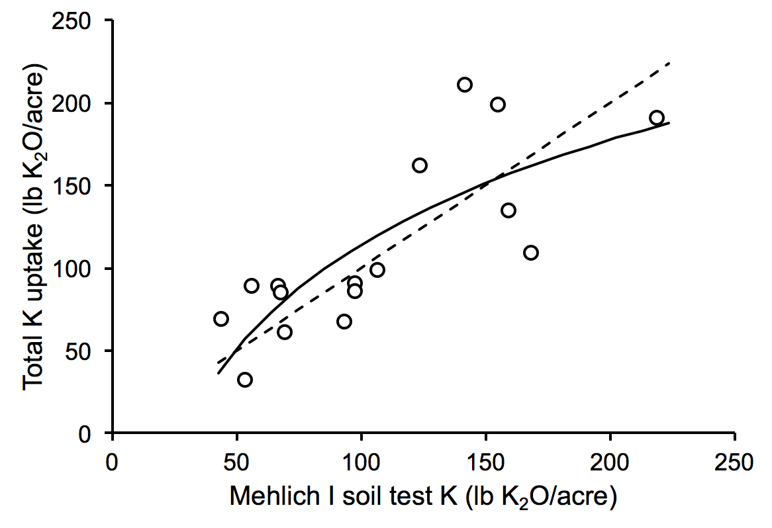
There Are Conditions where Soil Tests Can Quantify Most of the K Plants Access
K uptake = 91.2*ln(soil test K) – 306 R² = 0.62
1:1
Obreza, T.A. and F.M. Rhoads. 1988. Soil Science Society of America Journal 52:701-706.

Slide 13
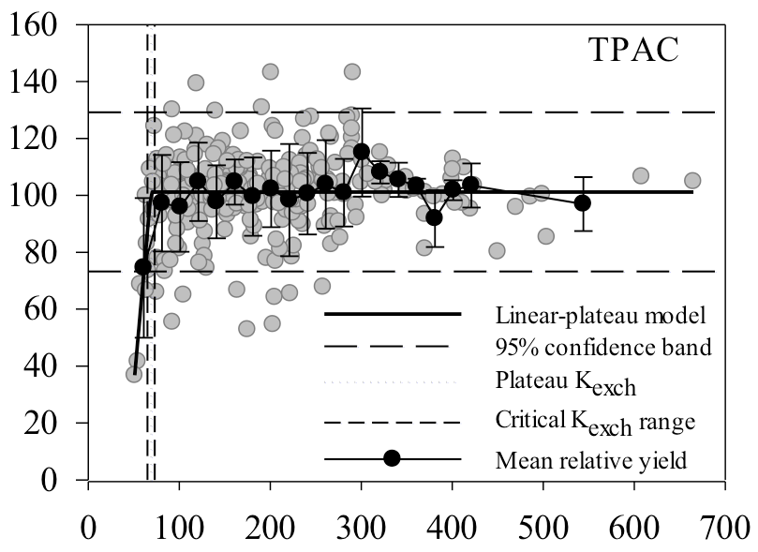
Example of a Location Where Lower Soil Tests Are Associated with Lower Yields
R.Navarette-Gonchozo. 2013. Personal communication (Purdue University)

Slide 14
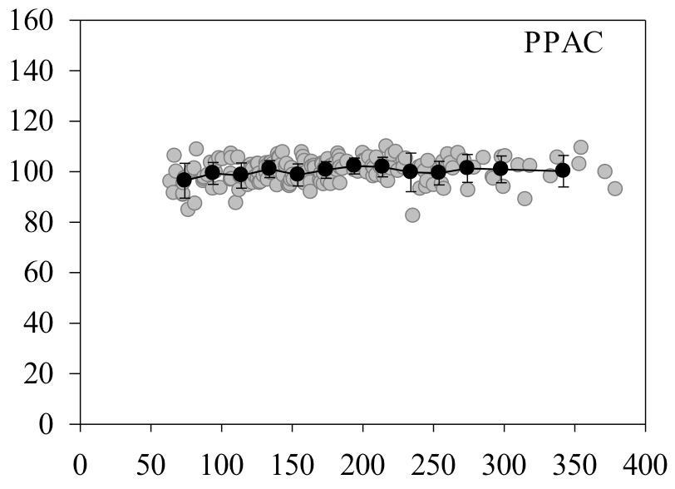
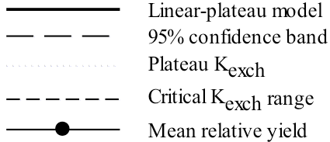
Example of a Location Where Lower Soil Tests Are Not Associated With Lower Yields
Tracy sand
R.Navarette-Gonchozo. 2013. Personal communication (Purdue University)

Slide 15
How Plants Access More K Than Is in a Soil Test

Slide 16
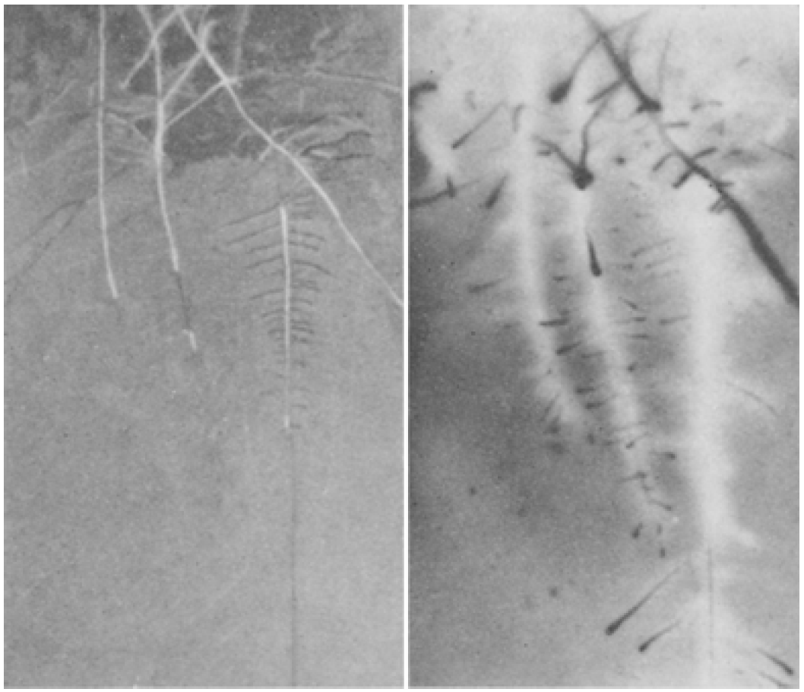
Visualization of Rhizosphere Volume Using Radioactive ⁸⁶Rb and X-Ray Film
Photograph of roots
Autoradiograph of ⁸⁶Rb depletion (lighter) and
accumulation (darker)
Walker, J.M. and S.A. Barber. 1962. Plant and Soil 17:243-259.

Slide 17
Overview of Ways Plants Access Potassium in the Rhizosphere
bacteria
K concentration
O
Root
OH
HO
O
H⁺
organic acids and other C compounds
Rhizosphere

Slide 18
How Plants Access More K Than Is in a Soil Test
Create concentration gradients in the rhizosphere

Slide 19
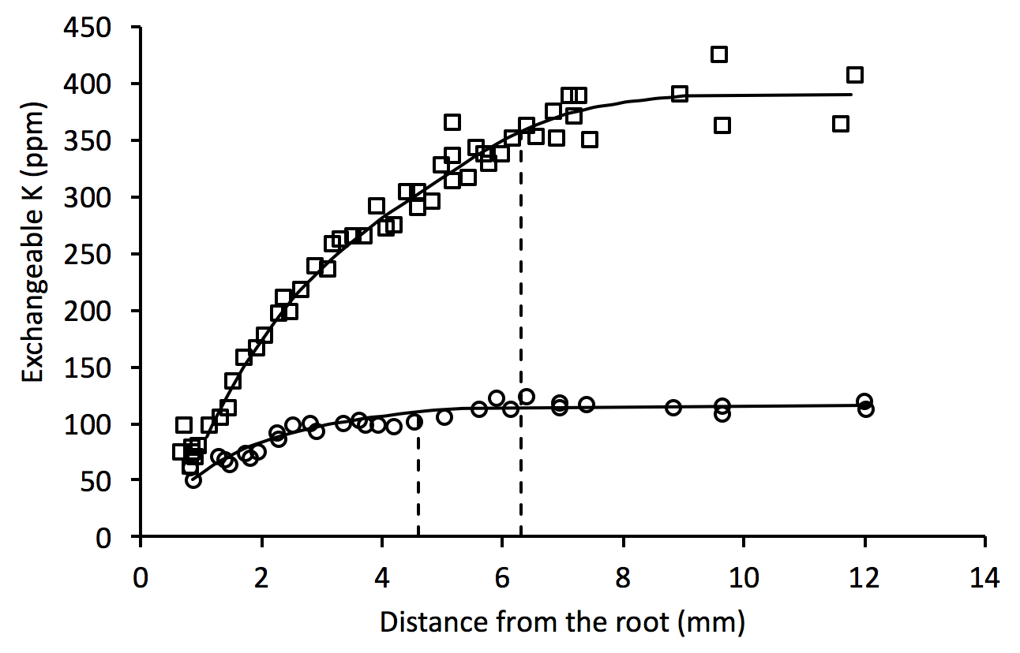
Depletion of K in the Rhizosphere (Oilseed rape after 7 days)
Fertilized
Unfertilized
Claasen, N., K.M. Syring, and A. Jungk. 1986. Plant and Soil 95:209-220.

Slide 20
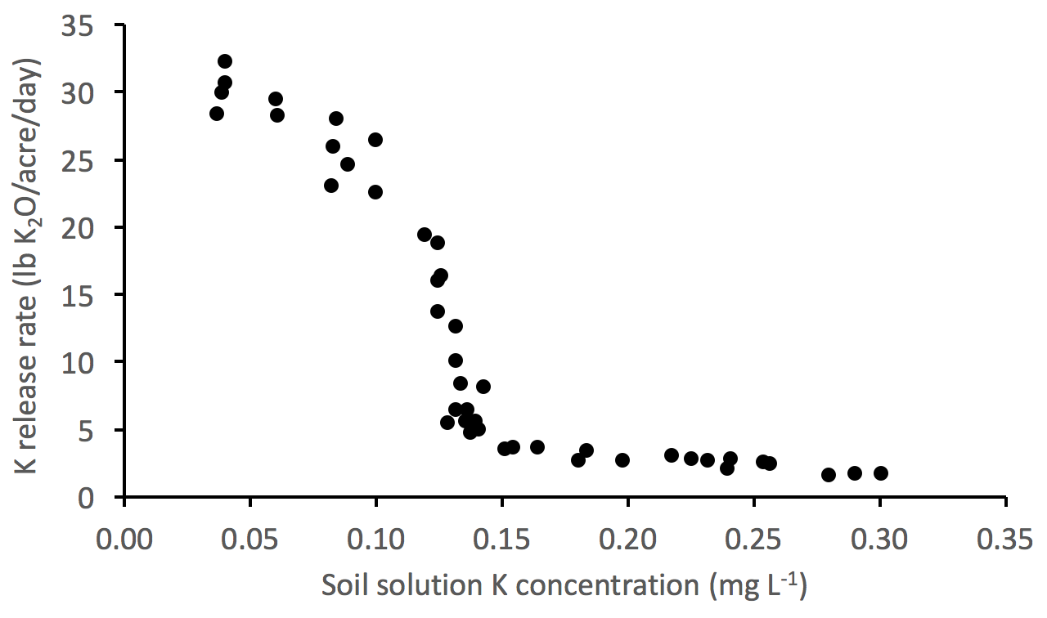
Rate of Release of Non-Exchangeable K
Threshold?
S.A. Barber (1995):
2-5 mg K L⁻¹ was the most observed soil solution K concentration range for 142 U.S. Midwestern soils
Barber, S.A. 1995. Soil nutrient bioavailability: A mechanistic approach. 2nd ed. John Wiley and Sons, New York, NY;
Springob, G. and J. Richter. 1998. Z. Pflanzenernähr. Bodenk. 161:323-329.

Slide 21
Root-Induced Mineral Transformations in the Rhizosphere
Starting mineral | Ending mineral | Crop | Duration | Reference
mica: biotite | vermiculite | wheat | 1 year | Mortland et al., 1956
mica: phlogopite | vermiculite | ryegrass | 4 days | Hinsinger et al., 1992
mica: phlogopite | vermiculite | ryegrass | 32 days | Hinsinger and Jaillard, 1993
mica: phlogopite | hydroxy-interlayered vermiculite | rape | 32 days | Hinsinger et al., 1993
General mechanism: Mica – K + movement of hydrated cations in the interlayer = vermiculite
Mortland, M.M. et al. 1956. Soil Science 82:477-481;
Hinsinger, P. et al. 1992. Soil Science Society of America Journal 56:977-982; Hinsinger, P. and B. Jaillard. 1993. Journal of Soil Science 44:525-534; Hinsinger, P. et al. 1993. Journal of Soil Science 44:535-545.

Slide 22
How Plants Access More K Than Is in a Soil Test
Exude H⁺ and organic acids into the rhizosphere

Slide 23
Proton Pump Aids Transport of Nutrient Ions across the Plasma Membrane
apoplasm
coupled transport
H⁺
H⁺
K⁺
plasma membrane
ATPase
H⁺
cytoplasm
ATP
H⁺
ADP + P_{i}
H⁺
K⁺
White, P.J. 2011. Ion uptake mechanisms of individual cells and roots. Chapter 2. In P. Marschner (ed.) Mineral Nutrition of Higher Plants. 3rd Ed.

Slide 24
Tectosilicates (Feldspars)
H⁺
H⁺
H⁺
H⁺ exchanges reversibly with K⁺ in the feldspar structure, releasing K⁺ into solution
Fenter, P. et al. 2000. Geochimica et Cosmochimica Acta 64(21):3663-3673.

Slide 25
Inorganic Acid (H⁺) in the Rhizosphere Can Exchange with Interlayer K
H⁺ exchanges with some K⁺ from the interlayer
Remaining K⁺ rearranges from structural ”holes” to the water interlayer
Layers collapse around the new interlayer structure
K⁺
H⁺
tetrahedron
octahedron
interlayer water
Park, M. et al. 2012. Journal of Physical Chemistry C 116:18678-18683.

Slide 26
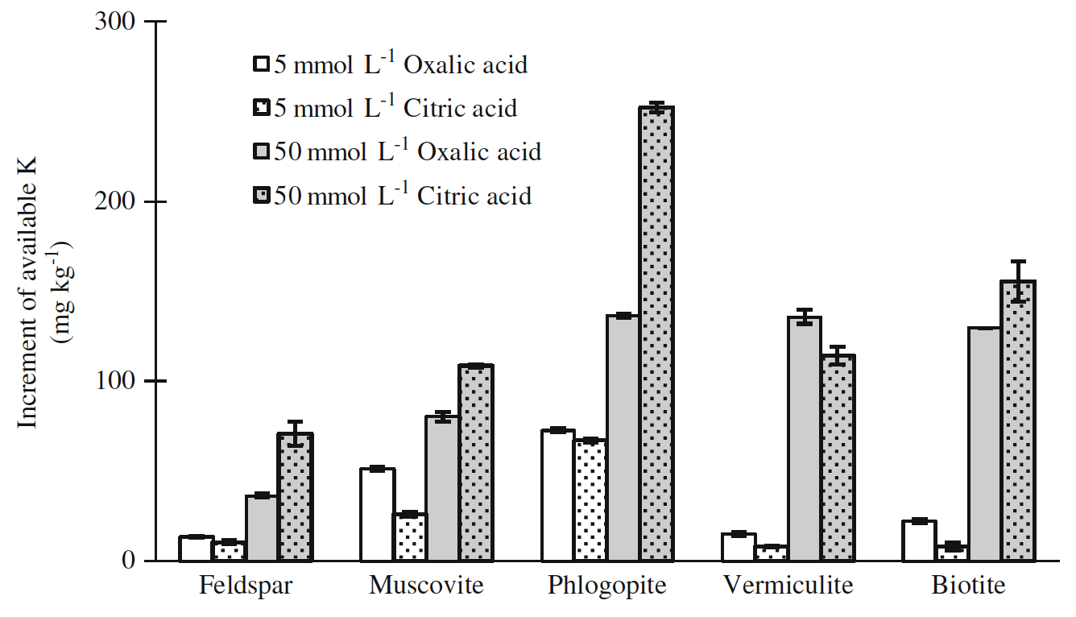
Organic Acids Release K from Minerals
Available K (ppm)
Wang, H.-Y. et al. 2011. Plant and Soil 343:209-220.

Slide 27
How Plants Access More K Than Is in a Soil Test
Form symbiotic relationships with microbial communities in the rhizosphere

Slide 28
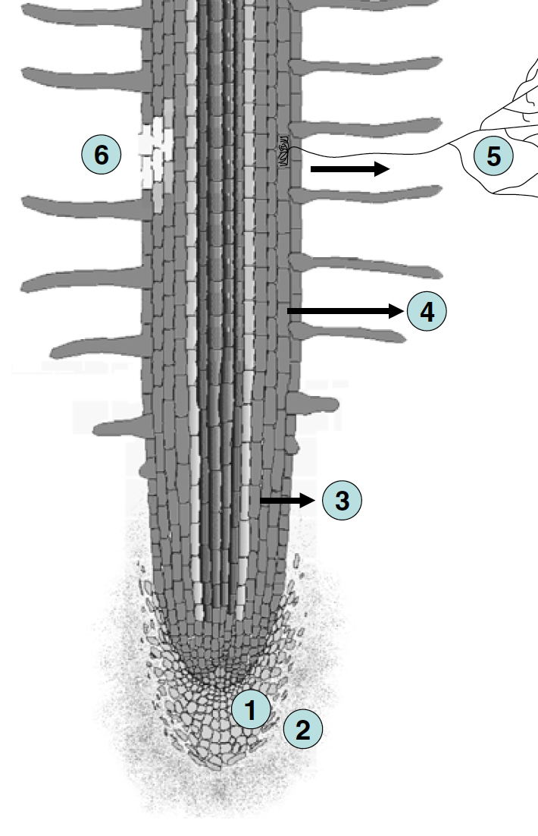
Rhizodeposition of Carbon Enriches the Rhizosphere
Loss of cells
Loss to symbionts
loss of volatile organic compounds
About 11% of plant carbon is deposited in the rhizosphere
loss of soluble exudates
loss of root cap and border cells
loss of mucilage
Jones, D.L. et al. 2009. Plant and Soil 321:5-33. Figure 1.

Slide 29
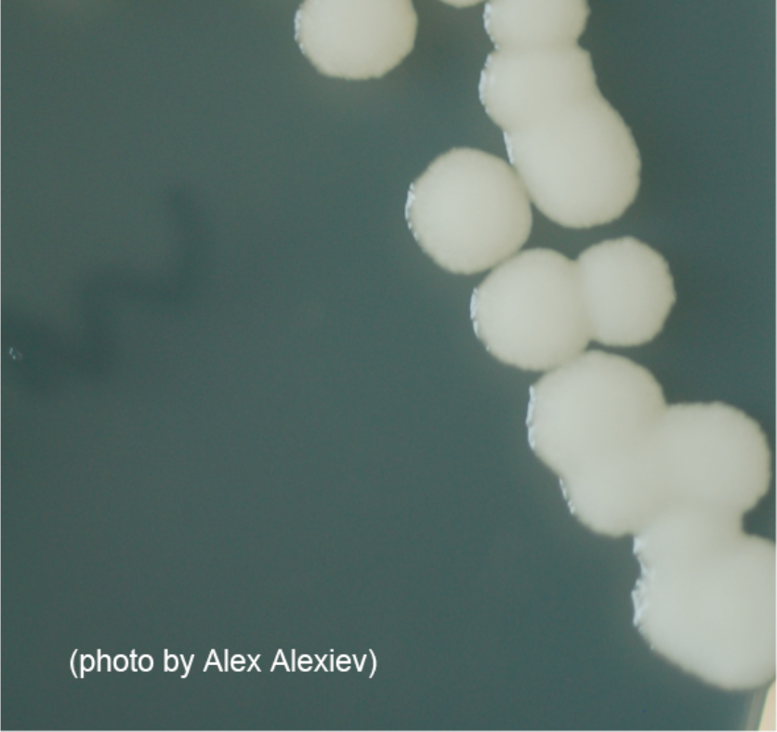
K-Solubilizing Bacteria (KSB)
KSB have been isolated from the rhizospheres of corn, banana, sugarcane, potato, pigeon pea, tobacco
KSB utilize carbon compounds in the rhizosphere
KSB produce H⁺ and organic acids that break down mineral structures
Paenibacillus mucilaginosus https://spacemicrobes.org/baseball_cards/ paenibacillus-mucilaginosus/
Meena, V.S. et al. 2015. Ecological Engineering 81:340-347;
Ullman, W.J. et al. 1996. Chemical Geology 132:11-17.

Slide 30
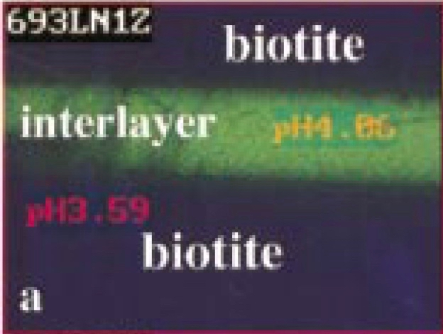
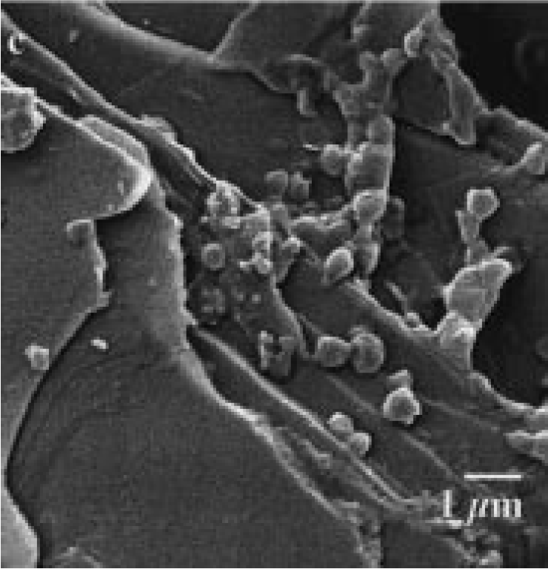
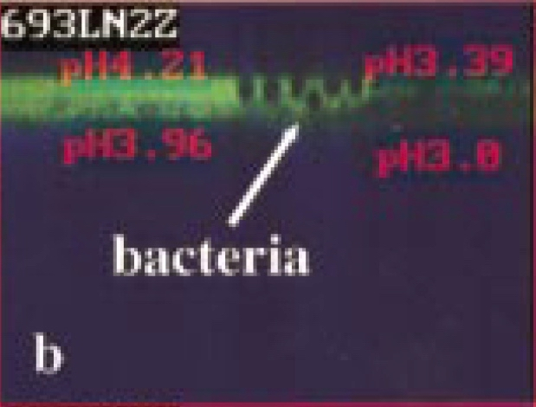
K-Solubilizing Bacteria (KSB)
Barker, W.W. et al. 1998. American Mineralogist 83:1551-1563. Figures

Slide 31
Where to from Here?

Slide 32
New K Recommendations in North Dakota
Yield response to K was reduced by the presence of K-feldspars
Soils with more illite had a critical soil test level 50 ppm lower than soils with less illite

Slide 33
How Can Lack of Yield Response on a Sand Be Explained?
Tracy sand
R.Navarette-Gonchozo. 2013. Personal communication (Purdue University)

Slide 34
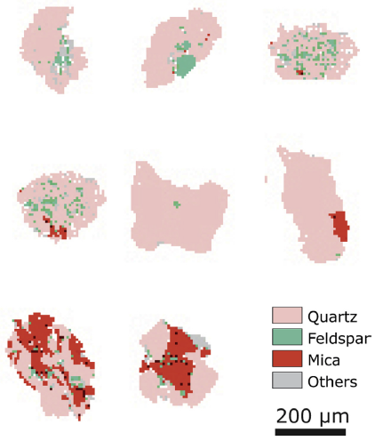
Fine Sand Particles Can Have Mineral Inclusions
Fine Sand (100 – 250 μm)
Individual quartz grains contained inclusions of
Feldspar
Mica
May help explain why some sands seem to have an adequate supply of K
Meyer, M.C., P. Austin, and P. Tropper. 2013. Quantitative evaluation of mineral grains using automated SEM-EDS analysis and its application potential in optically stimulated luminescence dating. Radiation Measurements 58:1-11.

Slide 35
The Future
Improvements in soil test extractants will get us only so far:
The sodium tetraphenyl boron test detects interlayer K, but the quantity extracted depends on the reaction time. Matching the results of this test to what a plant accesses will be difficult.
Ion exchange resins mimic roots as a “sink” for nutrients, but do not provide microbiomes for bacteria and other microorganisms
How well a particular soil test correlates with yield response or nutrient uptake will be highly dependent on the mineral composition of the soil and the hybrids/varieties being grown

